Slide 1
Introducing Oneself and Others

Slide 2
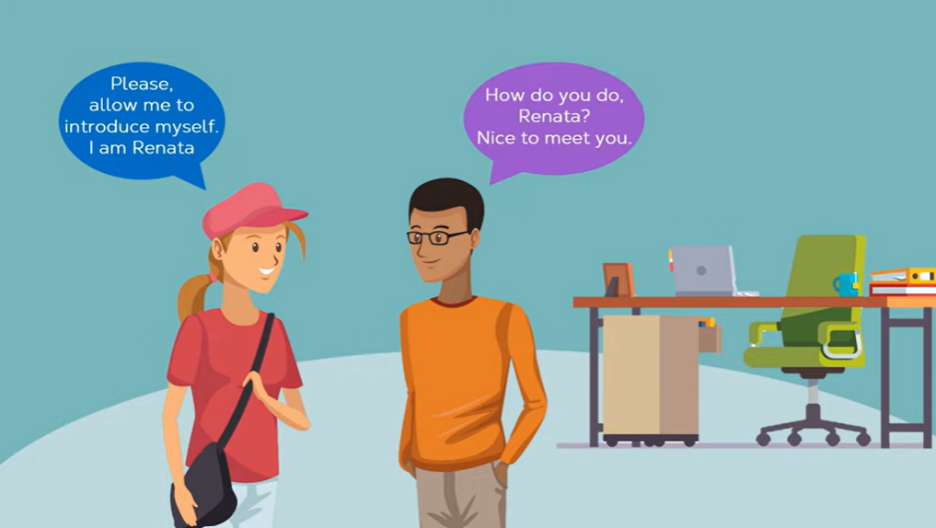

Slide 3
Introducing Oneself
Introducing oneself
Responses
Please allow me to introduce my self. I am ……
How do you do? Nice to meet you.
Good morning. My name is ……
Good morning. How do you do?
May I introduce myself? I am ….
I am….. Pleased to meet you.
Let me introduce myself. I am …
Hello. Glad to meet you.
Hello. My name is ….. And you?
Hello. My name is …..
Hi, I’m …..
Hi, nice to meet you.

Slide 4
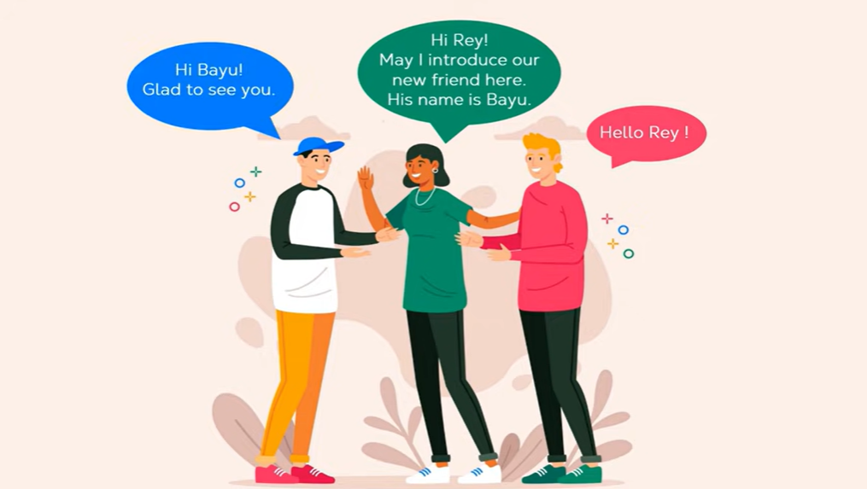

Slide 5
Introducing Others
Leila, this is Barbara. Barbara this is Leila.
I'd like you to meet …...
I'd like to introduce you to …..
Jack, have you met …..?
Jack, please meet Nicolas.
Responses
Hi. Glad to meet you.
No, I haven’t.
Hi. Glad to know you.

Slide 6
Greeting
Hi! / Hello!
Good morning / afternoon / evening.
How are you? / How are you doing?
How is life? / How is everything?

Slide 7
Leave taking / parting
Good bye!
Sorry, I have to go now.
It’s been nice talking to you.
Good night.
See you later.

Slide 8
ASKING
What do you do? | I am a nurse
Where do you work? | I work in Dr. Sulaiman Hospital
Do you like your job? | I love my job
Are you married /simgle? | I am single
Do you have a husband / wife (spouse)? | I have a husband (spouse)
Do you have any children? | I have three children
How many brothers and sisters do you have? | I have two sisters
How old are you? | I am 29 years od
When is your birthday? | It is on September 25th
When were you born? | I was born in 1998
Where are you from? | I am from Indonesia
Where do you live? | I live in Makassar
What’s your phone number? | My number is 081 333 555 666
What’s your email address? | mymailbox@gmail.com
What type of movies do you like? | I love drama movies
What type of music do you like? | I love Dangdut music
What sport do you like? | I love watching football
Do you have pets? | I have two cats
What’s your favorite food? | I love Coto Makassar

Slide 9
Introducing yourself as a nurse / midwife
Greetings:
- Hello
- Assalamu’alaikum
- Good Morning
- Good Afternoon
- Good Evening
Addressing someone:
- How can I address you?
- How can I call you?
- Is it “Miss or Mrs....?
- May I address you with....?
Introducing yourself and initial nursing interventions:
- I’m .......... (your name)
- I’m nurse ........... (your name)
- I’ll take care of you today
- I’ll take care of you in this ward
- My name is...
Response:
- Please, address me with...
- Please call me...
- You may address me...
- Why don’t you call me...

Slide 10
Pre-Closing:
- Now, I need to visit other patients
- If you need (anything/a help/something/assistance) please just
call me...
- If you need (anything/a help/something/assistance) please just
press the button, we will help you
- If you don’t need my help, I’ll visit other patients now. If you
need me, you can call me anytime...

Slide 11
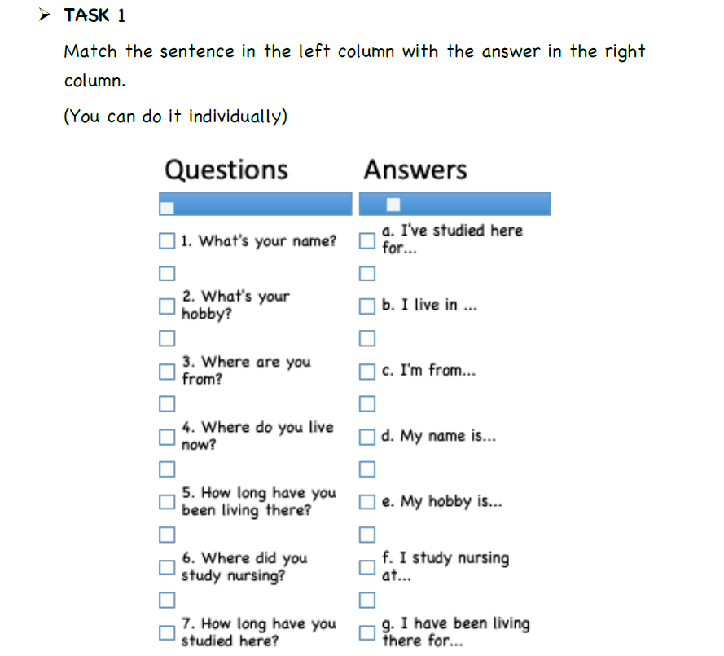

Slide 12
THANK YOU

