Slide 1
Ns.Asnuddin,S.Kep.,M.Kes

Slide 7
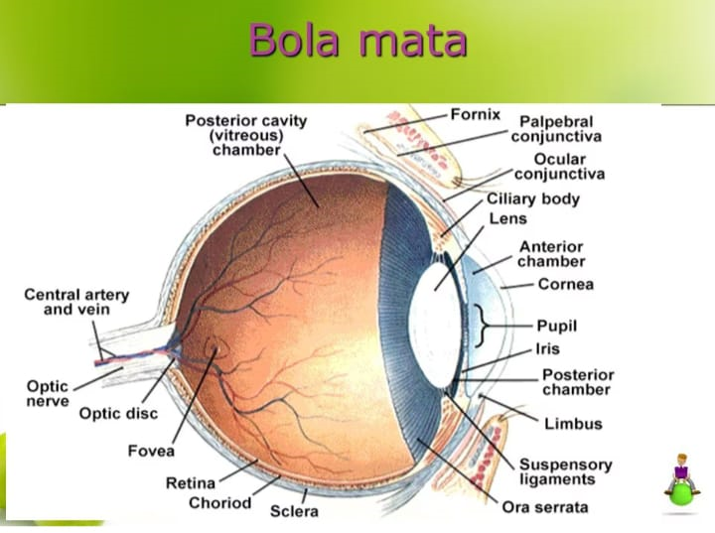

Slide 14
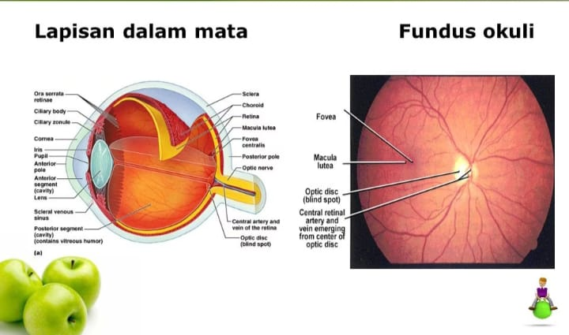

Slide 15
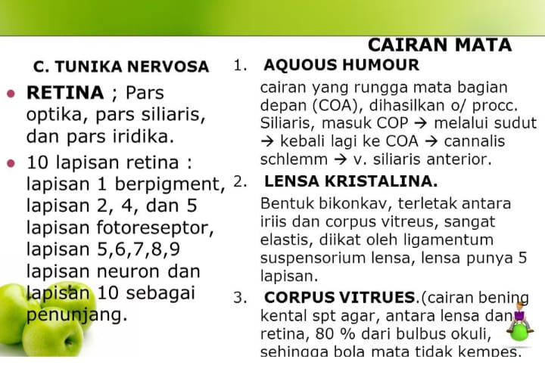

Slide 33
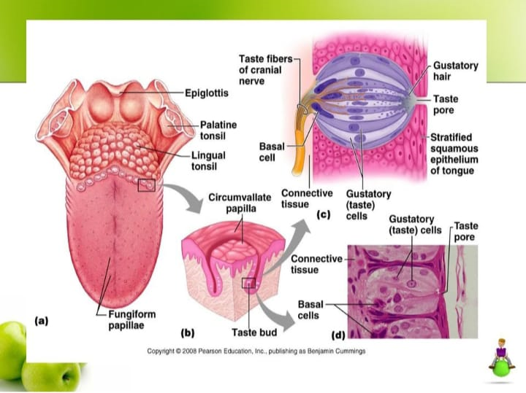

Slide 41
THANK YOU

